Slide 1
Belief Drives Behaviour Characteristics of Effective Whole School Data Practices.
Presenter: Brooke Brennan
MAV Conference Leaders Day
Date: 09/06/2022

Slide 2
Acknowledgement of country
As we gather for this workshop across various settings in a virtual construct let us take a moment to reflect the meaning of place and doing so recognise the various traditional lands on which we learn and share today.
We acknowledge the Elders – past, present and emerging of all the land we work, learn and live on and their Ancestral Spirits with gratitude and respect.
https://www.flickr.com/photos/georgiesharp/218995056
Notes:
https://teachik.com/aboriginal-art/

Slide 3
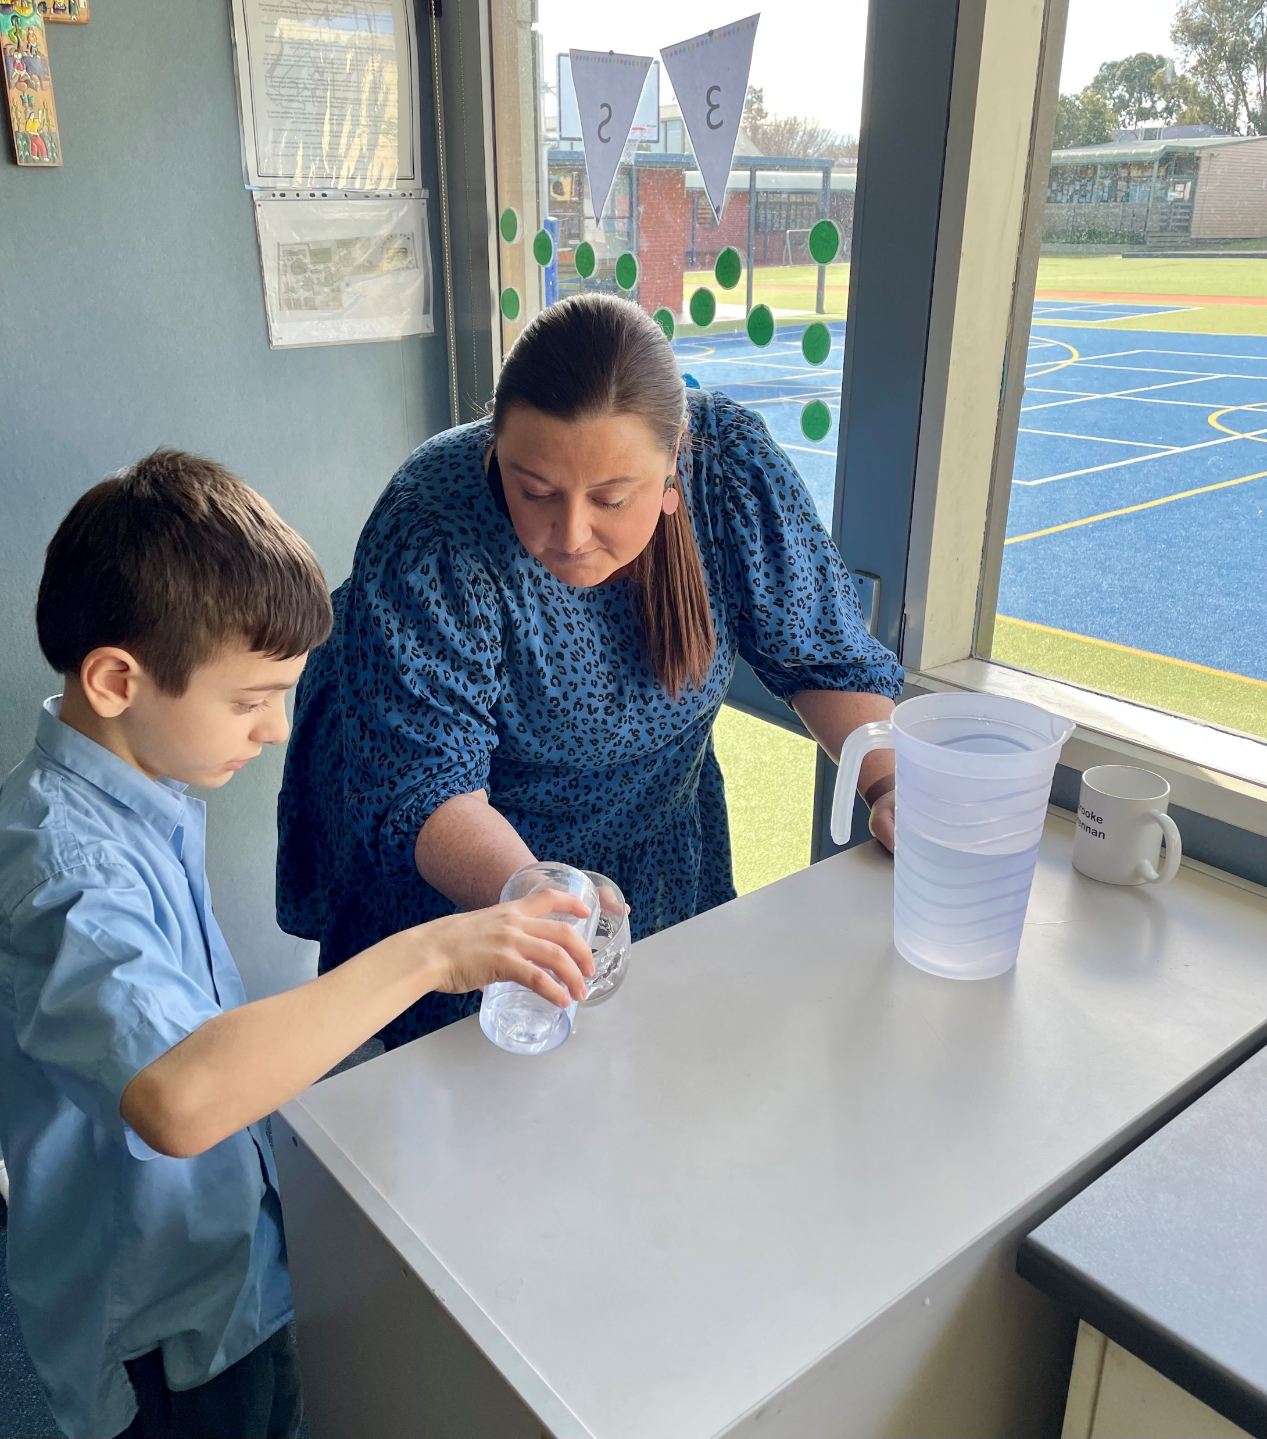
Introduction
St Francis of Assisi Mill Park
School Mathematics & Data
17 years experience across both primary and secondary
Passionate about
data literacy & leadership
school improvement and
assessment which drives improved student outcomes
Has a firm belief that given the right conditions and support, every student can learn.
I aim to help teachers become confident in making data informed decisions that can show real impact on their school contexts.
I believe that the best form of PD and school improvement happens when conversation amongst teachers are about their own students, their practice and their goals.
No matter the subject, collaboration between teachers is paramount.

Slide 4
Intentions for today
To share some knowledge and build capacity in the area of data literacy and looking at what components of a data program can be successful in a school context.
Discuss with others how your unique school context impacts the way you lead and drive change within your school.
Take away something you can use tomorrow with your team or in your classroom.

Slide 5
Warm Up Activity
Focus – Visualisation
Take a picture of three quarters in your head.
Now erase that picture in your head and take a different picture.
Notes:
Engage in math: make a picture of three quarters in your head (present this problem so that the symbol ¾ is not visible). Now erase that picture in your head and make a different picture.
Participants share the different pictures they made in their head . What is the same or different about what you visualized?(e.g. three 25 cent coins; a measuring cup with liquid to the ¾ indicator; a pie with ¾ remaining; a set of 4 balls three of which are red and one which is blue; a gas tank indicator with ¼ gas remaining).

Slide 6
Investigate
What can you assess in this visualization activity?
What data can you collect?
How can you record it?
Notes:
Whether students are using concrete, abstract or relational thinking
Students' ability to partition fractions or find fractions of a group
Students who can make multiple representations of the same fraction

Slide 7
Student of Wonder

Slide 8
Assessment Tiers

Slide 9
What are you analsying most?
Share what elements of your schools data program you feel gets the most attention.

Slide 10
Growth Based Pedagogy
“Effective school leaders create the conditions for growth and progress, enabling others to understand their impact on student outcomes and seek constant improvement.” (Horizons of Hope Leadership Strategy Statement, 2019)

Slide 11
Why a vision watermark?
“As a school, we reflect on the whole school shared beliefs and understandings by attending to our design principles. We ensure this is demonstrated through words and actions. We have shared responsibility and accountability towards student learning and data and we work collaboratively to ensure the learning and growth of all. Everyone, Everywhere, Everyday. This is the SFOA WAY.”
(St Francis of Assisi Learning & Teaching Pedagogical Framework, 2020)

Slide 12
Influenced by the work of Lyn Sharrat

Slide 13
Shared Accountability, Shared Action and Belief
Hearing others' ideas and suggestions
Making connections between like needs students
Inspired to try those ideas
Looking at different ways to gather assessment data such as videos, additional work samples.
OUR STUDENTS NOT MY STUDENTS – EVERY FACE IN OUR SCHOOL DESERVES TO GROW IN MATHEMATICS LEARNING

Slide 14
Why examine data practices?
There is a significant bank of research into why teachers should use data within their classrooms (Sharrat & Fullan, 2012; Masters, 2018; Sharrat, 2019; Hattie, 2008) but limited research on how leaders can support the implementation of this in a supportive and constructive way or what specific features of a school’s data practices make them more effective.
Currently there are few consistent frameworks with which schools can engage with data and assist in scaffolding the role leaders play in supporting a consistent approach to data set analysis, use and culture within schools.

Slide 15
SWOT ANALYSIS
Let’s examine the Strengths, Weaknesses, Opportunities and Things to consider in your own context.

Slide 16
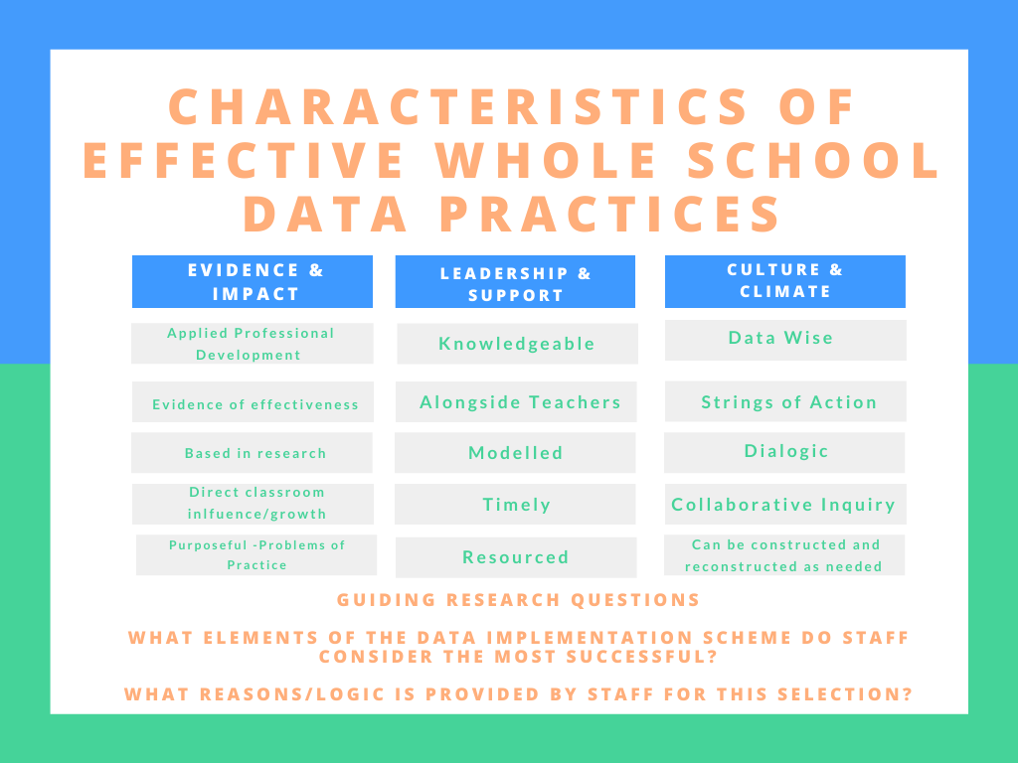
Brennan, 2021

Slide 18
Big Questions from the Research
What does it all look like in leadership decision making and then in classrooms?
What data and why?
How can we make it easier for teachers to track and make changes to their practice ‘on the fly’?
How can we unlock the pockets of excellence in our school and hear all voices?
How do we find the time?

Slide 19
Big Focus Areas
Collections and storage of data
Whole school assessment schedules, policies and designs
What, when, where and how data is analysed
Planning for Student Learning
Enacting Curriculum Designs
Teacher Pedagogical Reflection and Professional Learning
Student Learning, Voice and Goal Setting
Data Literacy and Visibility

Slide 20
Beyond Spreadsheets
The numbers are fine, but:
“We are wired to feel things for people, not numbers.”
It is about lifting the narrative of each learner off the page.
The numbers are the start of the conversation, but the conversation is what is important.

Slide 21
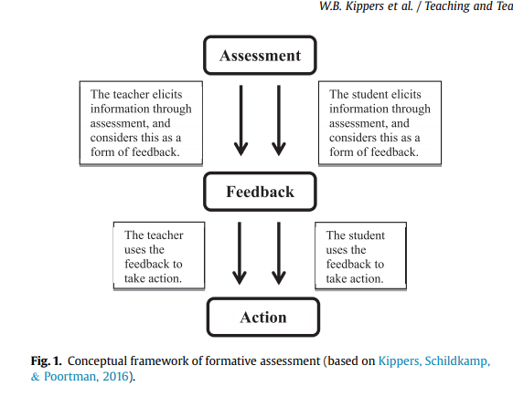
Data must = action

Slide 22
Within our context…
AAP called for us to examine how to improve student growth, we know that our students have capacity but need opportunity.
As we know, not all thinking or knowing is the same.
Yet 80% or more of all questions teachers ask (spoken or written) can be answered with lower-order thinking skills:
–by recall or remembering
–by knowledge
–by simple handling of a restricted set of ideas, data, knowledge
If we can develop students’ higher-order thinking skills this will enhance their metacognitive abilities and hence their learning.
Shift to Solo Taxonomy as an instructional strategy to improve higher order thinking.
WE NEEDED TO SHIFT THE CLASSROOM DATA PRACTICES BEFORE WE COULD TRACK THE TIER 1 DATA FOR CHANGES
METACOGNITIVE STRATEGIES – EFFECT SIZE 0.69

Slide 23
How can we track this data?
Venn Diagram to split kids into
Mastery, Some progress and
Needs Consolidation.
This could be ‘Got it’, ‘
Getting it’ or ‘ Not yet’.
Working, Wobbly, Worried (Sharrat, 2017)
Achieved the skill, some of the
skill, needed support or couldn’t
do the task
Modify to suit your class

Slide 24
Monitoring Circles

Slide 25
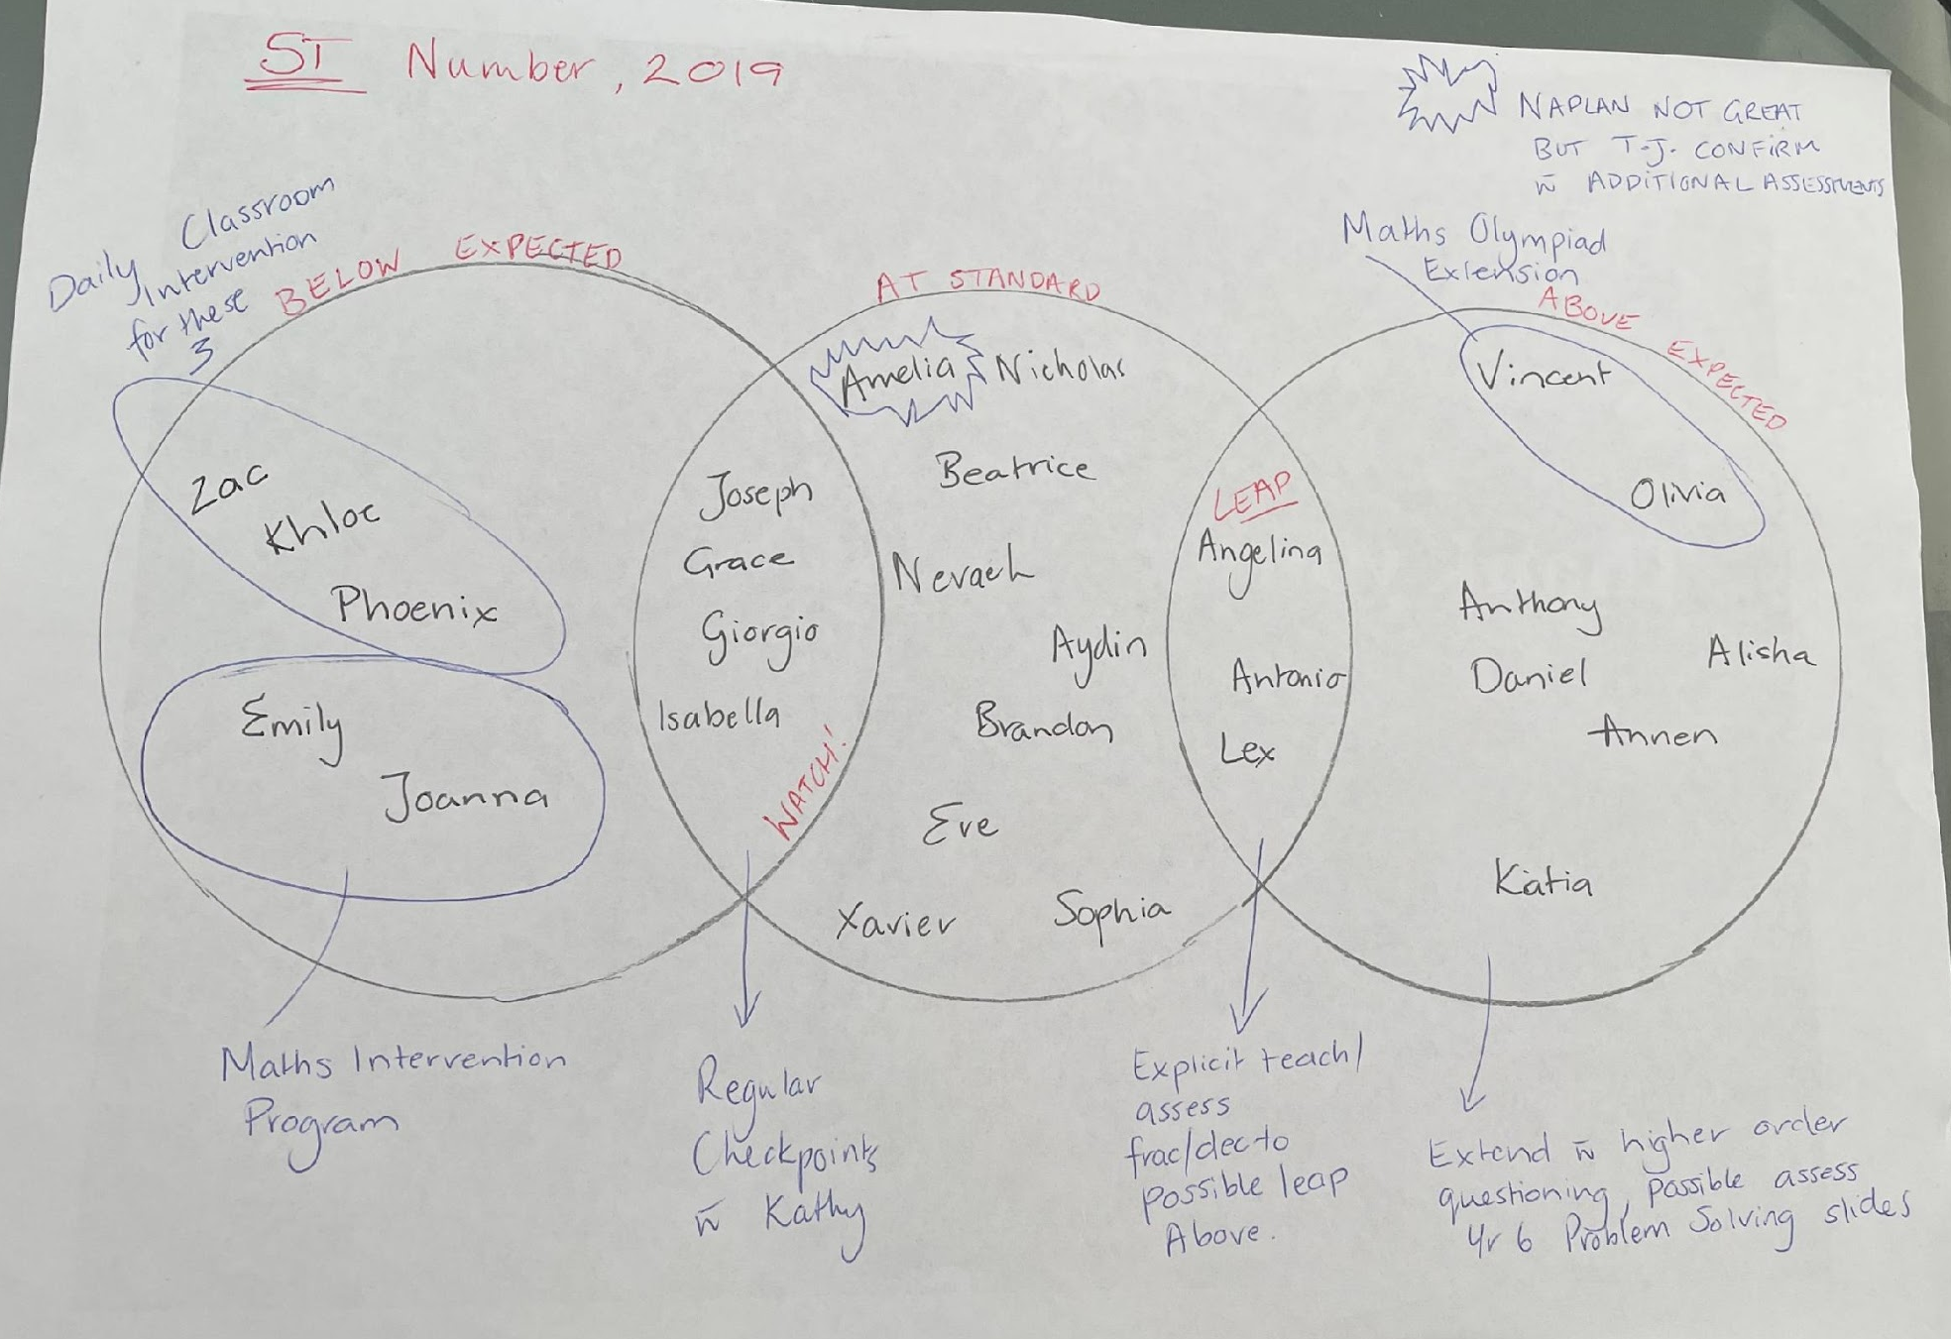

Slide 26
Responding to student needs is data in action
Gathering evidence of student learning isn’t enough.
It is the changes teachers make to their instruction in light of what they have learnt about their students that makes the difference.

Slide 27
Some things to remember…
Don’t go it alone, tasks should be robustly planned and discuss at a team level to ensure that the learning outcomes are understood and that the assessment and adjustment on the fly looks natural!
Robust conversations about data and work samples will bring the spreadsheet to life every time.
Notes:
Good quality teaching AND planning

Slide 28
Time Worthy Tasks
Holt (2021) refers to Time Worthy Tasks as being rich or engaging tasks that have the potential to “stimulate interest, provide challenge and extend the knowledge of all student”
One of the 10 key components of a Time Worthy Task is that it should support formative assessment practices.
The task should: “encourage self, peer and teacher assessment designed to give feedback about an aspect of the work, e.g. to identify patterns or errors, reflection on what they have learnt, show progress towards goal and/or makes suggestions for future learning.
“When feedback focuses not on the person, but on the strengths and weaknesses of the particular piece of work and what needs to be done to improve, performance is enhanced.” (Hodgen & William, 2006). “We learn so much from errors and from the feedback that then accrues from going in the wrong direction or not going sufficiently in the right direction. (Hattie, 2008) “It is what you learn after you have solved the problem that really counts.” (Wilson, Fernandez, & Hadaway, 1993).”
(Holt, 2021) https://www.200hours.com.au/attributes-of-a-time-worthy-task

Slide 29
What is your favourite task?
We all have a favourite tasks that we love to use each year with students.
Think of yours, what is it?
How do you know it’s a great task?
What information do you get from it?
Do you and your teachers prioritise these tasks in your planning?

Slide 30
Telling your students’ stories
Assessment is a means of uncovering the narrative of learners: their growth, progress, success and challenges in learning.
Through such assessment, teachers gain valid and reliable evidence of a student’s learning, which enables them to make precise decisions for the growth and progress of their learners.
What does this mean for YOUR students?
What does this mean for YOUR Teachers?
What does this mean for YOUR Families?
How do we collect the best evidence to reflect our practices around this?

Slide 31
Dialogic Approach
Many schools have poured money into data and school improvement with a specific focus on data analysis and more often than not this is achievement based improvement.
Within this space there is a worrying trend of schools having data, analysing it but not knowing what to do with it, or forgetting that behind the numbers are real life students and missing the most important part of the data process,
The conversation AMONGST teachers, ABOUT students. DIALOGUE! Teachers who are engaged in a dialogic approach to data are better able to diagnose and act on their students' learning needs and more effectively use evidence based instructional strategies.

Slide 32
Dialogic Approach
Masters (2018) advocates that “understanding where learners are in their learning is as essential to clinical teaching practice as understanding a patient’s symptoms and health is to effective medical practice.” This means that work around data at the school level must directly flowed into the schools focus on evidence informed practices and be seen as vital important to the “on the ground”, work of teachers.

Slide 33
Dialogic Approach
Don’t go it alone, your best PD is often the teacher next door and the same goes for looking at data. I’ve learnt more from a 5 minute conversation with a colleague than I’ve learnt at some 3 day PD’s. Similarly, it’s no good giving staff a spreadsheet with their classes PAT data on it and not making time for the rich, professional discussion that it deserves.

Slide 34
Just In Time Vs Just in Case
Discovering what students know while they’re still in the process of learning it—can be tricky, but data is useless unless it is used. When we collect and examine formative assessments, we need to use what we learn from them to inform instruction. All of those data points tell us something we can use to provide timely feedback, adjust instruction, and plan ahead.
Formative assessment and feedback tools need to be in use to ensure that you target your instruction in your students' point of need.

Slide 35
3 Key Themes
Individual Teacher Support, Technical Support & Cultural Support
Like 3 legs of a chair, if one is missing the chair falls down

Slide 36
Shared Everything THE SFOA WAY
“a community of practice is capable of crafting a shared identity around mutual engagement, joint enterprise and shared repertoire of its members.”

Slide 37
Grow, Ditch & Amplify in your own context

Slide 38
“It is critical to have a laser-like focus on every FACE in order to increase achievement. Hope is not a strategy!”
(Sharratt, 2019)

Slide 39
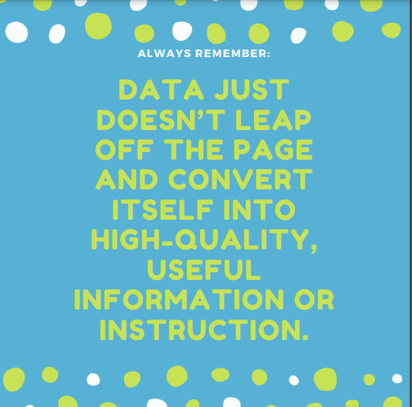

Slide 40
Ticket to Leave
What can you take away and
implement in your own practice?
Is there anything you think might
be purposeful to your teams?
Thank you so much for taking the time today to share this professional learning with me.

Slide 41
Discussion

Slide 42
Feedback + Follow Up
bbrennan@sfmillpark.catholic.edu.au madamemathseducation@gmail.com
https://www.facebook.com/madamemathsau
@madamemaths

